Slide 1
Workspace Window

Slide 2
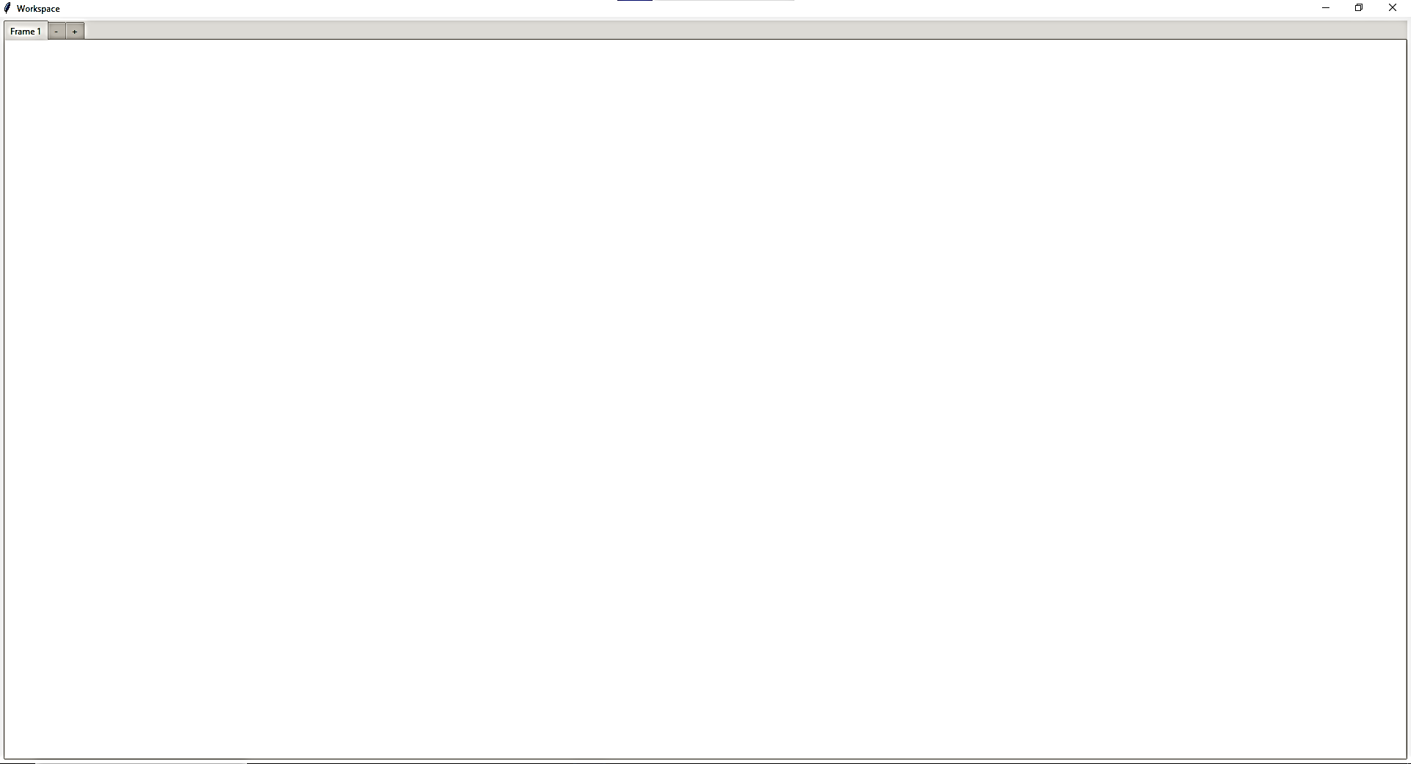
Current UI as of 13/06/2024

Slide 3
Further Developments:
Insert a menubar with various functionality

Slide 4
Widget Catalog

Slide 5


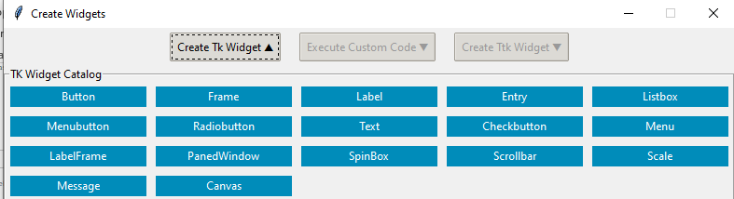
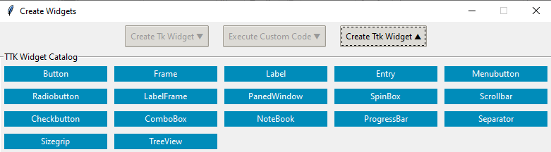
Current UI as of 13/06/2024

Slide 6
Further Development:
Add a styling window through TTK Widget Catalog for TTK widget styling
Disable Close Button

Slide 7
Widget Creation UI

Slide 8
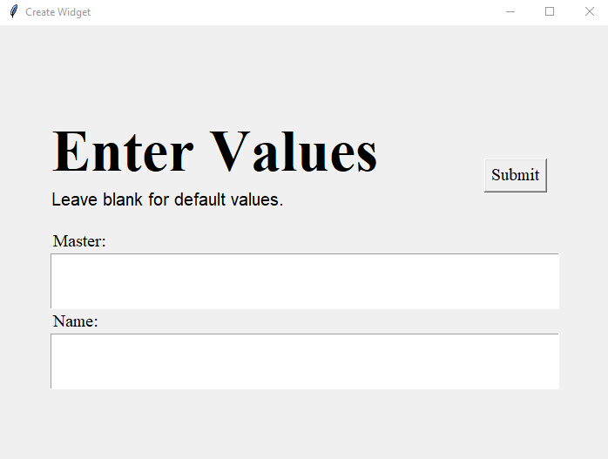
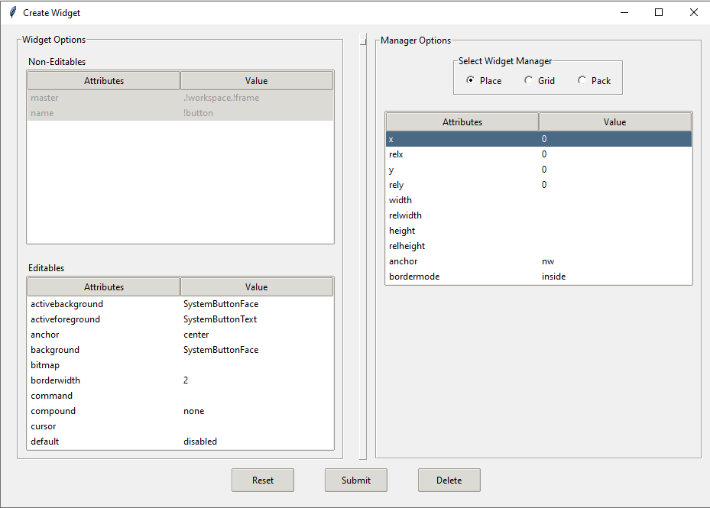
Current UI as of 13/06/2024
Frame 1
Frame 2

Slide 9
Further Development:
Integrate Frame 1 into Frame 2
Integrate Custom User Code widget and save its output referencing to the particular widget.
Add variable name option for widget to code conversation
Add a section to display code of the particular widget along with a button to copy it.

Slide 10
Widget Updation UI

Slide 11
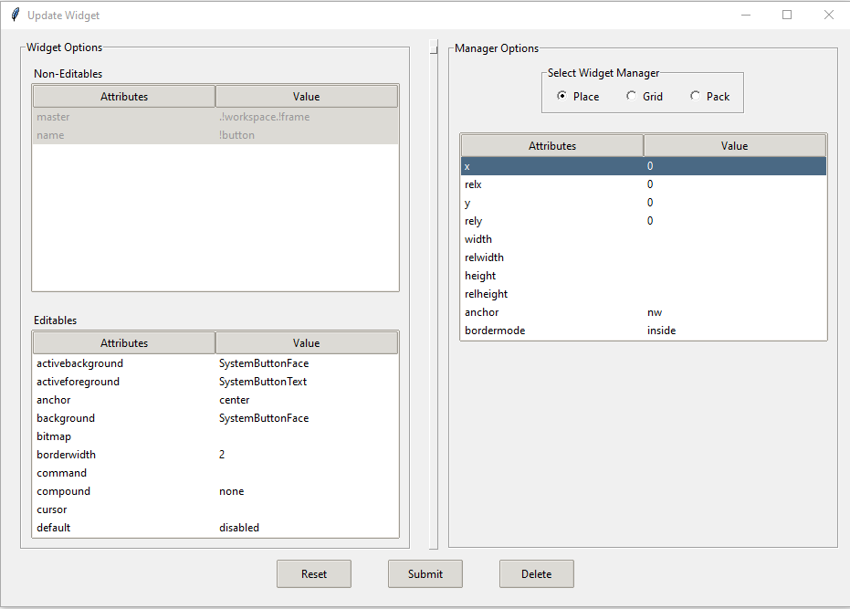
Current UI as of 13/06/2024

Slide 12
Further Development:
Integrate Custom User Code widget and save its output referencing to the particular widget.
Add variable name option for widget to code conversation
Add a section to display code of the particular widget along with a button to copy it.

Slide 13
Custom User Code Window
Coming soon

Slide 14
Styling Window
Coming soon

Slide 15
Save UI Window
Coming soon

Slide 16
Menu Bar
Coming soon

